Slide 1


Slide 2

Supporting our clients, people and community
We invested to support and prioritise the health and wellbeing of our key stakeholders
Our clients
Paused home loan repayments for ~11% of AMP Bank mortgage clients
Paid A$1.8b in early release of super to clients
in need
Assisted clients with over one million client conversations during COVID-19
Supported AMP Capital tenants with flexibility of rent payment terms and trading hours
Launched partnership with Good Shepherd to provide free confidential financial counselling to AMP clients experiencing hardship
Our people
Rapidly scaled remote working technologies enabling 95% of employees to work flexibly
Coordinated and delivered key projects including one of the largest successor fund transfers in Australian history while working remotely
Launched wellbeing initiatives to support employees
Initiated inclusive leadership training for senior leaders
Our community
Supported COVID-19 impacted charities through emergency A$2m grants program from
AMP Foundation
Delivered A$1m AMP Tomorrow Fund program
for extraordinary Australians for seventh year
Employees donated >A$700,000 in 2020 through payroll giving and fundraising
Launched Innovate Reconciliation Action Plan (RAP), building on strong progress since the 2019 launch of AMP Capital’s Reflect RAP
Converted several AMP Capital infrastructure assets to COVID-19 crisis centres and community assessment clinics
Notes:
All data refers to 2020 unless otherwise stated

Slide 3
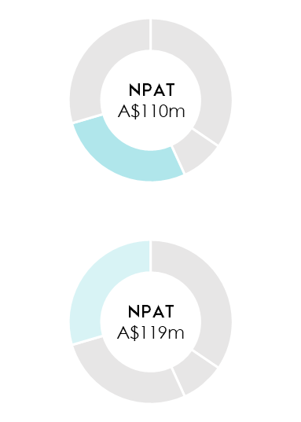
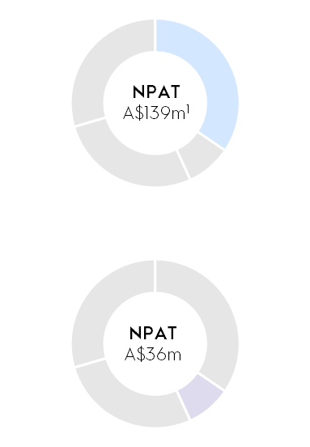
2020 business unit performance
AMP Australia wealth management Strong transformation momentum; clients prioritised through COVID-19 | AMP Capital Asset Management Demand for real assets; COVID-19 impacted performance fees, earnings and asset valuations
AMP Australia AMP Bank COVID-19 provision impacted earnings in 2020; major technology platform renovation delivered, positioning for growth | New Zealand wealth management Agile and well positioned for delivery following localisation of operations
The AMP Capital business unit results and any other impacted line items are shown net of minority interests. AMP regained 100% ownership of AMP Capital and MUTB’s minority interest consequently ceased on 1 September 2020.

Slide 4
Reinventing AMP
overall_1_132090351703926483 columns_1_132090351703926483
Refocusing our portfolio to higher growth, higher return businesses
Australian Wealth Management Simpler client-led wealth manager with tailored offering to meet the needs of Australians | AMP Bank Technology enabled challenger bank that integrates with clients’ wealth management needs | AMP Capital Leading global asset manager expanding private markets through differentiated active management capabilities | New Zealand Wealth Management Leading wealth manager and general insurance provider | Partnerships Strategic partnerships giving access to diversified shareholder returns and strategic growth opportunities
Enablers of long-term shareholder value
Redefining the business portfolio by shifting capital allocation to higher growth, higher return assets
Disentangling the value chain to enable operational efficiency and improved cost management
Strengthening our culture to drive accountability, inclusion and high-performance

Slide 5
Progress update towards reinventing AMP
Delivered 90% of 2020 market commitments while navigating significant market disruption
Our progress
1H 20
2H 20
Simplify portfolio | Complete sale of AMP Life by 30 June
 | Update on New Zealand wealth management divestment process at or before 1H 20
Reinvent wealth management in Australia | Continued focus on reshaping advice to be more professional, compliant and productive
 | Deliver stage one of superannuation product and platform simplification
 | Maintain platform growth trajectory; continue investment in platform, enhance EFA proposition
 | Complete AMP Bank platform modernisation, enabling scaled growth beyond FY 20
Grow asset management | Deploy committed capital, continue to expand global footprint for next round of client fundraisings
Create a simpler, leaner business | Deliver A$140m cumulative gross savings; establish end-to-end businesses across AMP group
 | Complete the investment of A$100m (pre-tax) in risk, governance and controls by end of FY 20
 | Drive cultural change focusing on accountability and execution

